Slide 1
Introduction: roadmap
  1.1 What is the Internet?
  1.2 Network edge
  1.3 Network core
  1.4 Network access and physical media
  1.5 Internet structure and ISPs
  1.6 Delay & loss in packet-switched networks
  1.7 Protocol layers, service models
  1.8 History
Introduction
2-<number>

Slide 2
Internet structure: network of networks
roughly hierarchical
at center: small # of well-connected large networks
  “tier-1” commercial ISPs (e.g., Verizon, Sprint, AT&T, Qwest, Level3), national & international coverage
  large content distributors (Google, Akamai, Microsoft)
  treat each other as equals (no charges)
IXP
IXP
tier-1 ISPs &
content distributors, interconnect (peer) privately
Tier 1 ISP
large content
distributor
(e.g., Akamai)
large content
distributor
(e.g., Google)
Tier 1 ISP
Tier 1 ISP
… or at Internet exchange points IXPs
Introduction
2-<number>

Slide 3
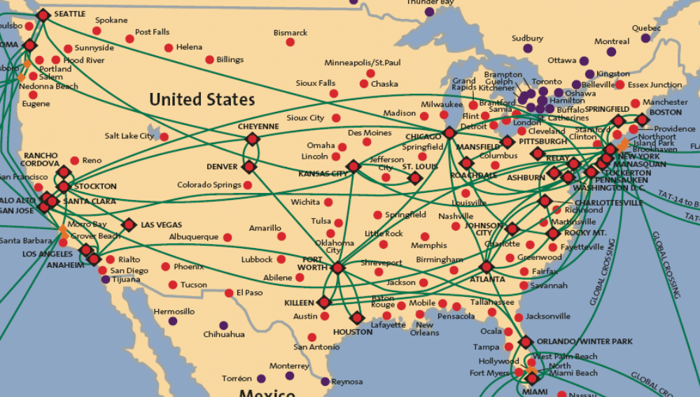
Tier-1 ISP: e.g., Sprint
POP: point-of-presence
to/from backbone
peering
…
…
…
…
…
to/from customers
Introduction
2-<number>

Slide 4
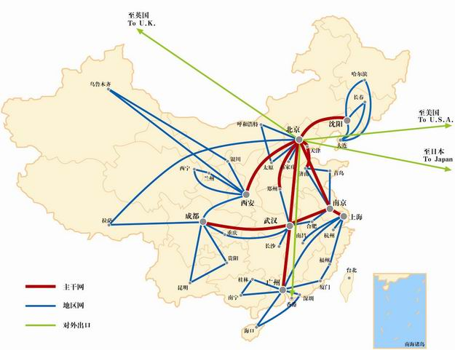
Packet switching Vs. Circuit switching

Slide 5
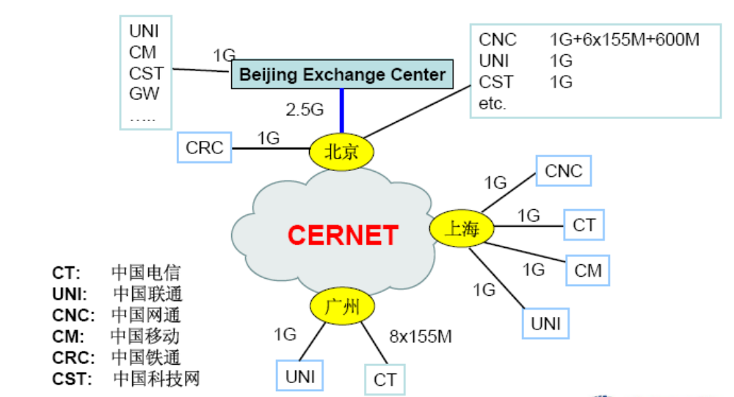

Slide 6
Internet structure: network of networks
“tier-2” ISPs: smaller (often regional) ISPs
  connect to one or more tier-1 (provider) ISPs
    each tier-1 has many tier-2 customer nets
    tier 2 pays tier 1 provider
  tier-2 nets sometimes peer directly with each other (bypassing tier 1) , or at IXP
Tier 2
ISP
IXP
IXP
Tier 2
ISP
Tier 2
ISP
Tier 1 ISP
Large Content
Distributor
(e.g., Akamai)
Large Content
Distributor
(e.g., Google)
Tier 1 ISP
Tier 1 ISP
Tier 2
ISP
Tier 2
ISP
Tier 2
ISP
Tier 2
ISP
Tier 2
ISP
Tier 2
ISP
Introduction
2-<number>

Slide 7
Internet structure: network of networks
“tier-3” ISPs, local ISPs
customer of tier 1 or tier 2 network
  last hop (“access”) network (closest to end systems)
Tier 2
ISP
IXP
IXP
Tier 2
ISP
Tier 2
ISP
Tier 1 ISP
Large Content
Distributor
(e.g., Akamai)
Large Content
Distributor
(e.g., Google)
Tier 1 ISP
Tier 1 ISP
Tier 2
ISP
Tier 2
ISP
Tier 2
ISP
Tier 2
ISP
Tier 2
ISP
Tier 2
ISP
Introduction
2-<number>

Slide 8

Internet structure: network of networks
a packet passes through many networks from source host to destination host
Tier 2
ISP
IXP
IXP
Tier 2
ISP
Tier 2
ISP
Tier 1 ISP
Large Content
Distributor
(e.g., Akamai)
Large Content
Distributor
(e.g., Google)
Tier 1 ISP
Tier 1 ISP
Tier 2
ISP
Tier 2
ISP
Tier 2
ISP
Tier 2
ISP
Tier 2
ISP
Tier 2
ISP
Introduction
2-<number>

Slide 9
introduction: roadmap
  1.1 what is the Internet?
  1.2 network edge
    end systems, access networks, links
  1.3 network core
    packet switching, circuit switching, network structure
  1.5 Internet structure and ISPs
  1.6 delay, loss, throughput in networks
  1.7 protocol layers, service models
  1.8 networks under attack: security
  1.9 history
Introduction
2-<number>

Slide 10
How do loss and delay occur?
packets queue in router buffers
packet arrival rate to link (temporarily) exceeds output link capacity
packets queue, wait for turn
packet being transmitted (delay)
A
B
packets queueing (delay)
free (available) buffers: arriving packets
dropped (loss) if no free buffers
Introduction
2-<number>

Slide 11
Four sources of packet delay
transmission
A
propagation
B
nodal
processing
queueing
d_{nodal} = d_{proc} + d_{queue} + d_{trans} + d_{prop}
处理时延d_{proc}: nodal processing
check bit errors
determine output link
typically < msec
d_{queue}: queueing delay
time waiting at output link for transmission
depends on congestion level of router，无法预测
Introduction
2-<number>

Slide 12
Four sources of packet delay
transmission
A
propagation
B
nodal
processing
queueing
d_{nodal} = d_{proc} + d_{queue} + d_{trans} + d_{prop}
d_{trans}: transmission delay:
L: packet length (bits)
R: link bandwidth (bps)
d_{trans} = L（一个包的bit数量）/R（线路带宽）
d_{prop}: propagation delay:
d: length of physical link
s: propagation speed in medium (~2x10⁸ m/sec)
d_{prop} = d/s
d_{trans} and d_{prop}
very different
Introduction
2-<number>

Slide 13
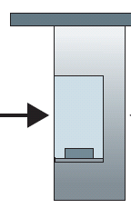

Caravan analogy
100 km
100 km
ten-car
caravan
toll
booth
toll
booth
cars “propagate” at
100 km/hr
toll booth takes 12 sec to service car (bit transmission time)
car~bit; caravan ~ packet
Q: How long until caravan is lined up before 2nd toll booth?
time to “push” entire caravan through toll booth onto highway = 12*10 = 120 sec
time for last car to propagate from 1st to 2nd toll both: 100km/(100km/hr)= 1 hr
A: 62 minutes
Introduction
2-<number>

Slide 14
Caravan analogy (more)
100 km
100 km
ten-car
caravan
toll
booth
toll
booth
suppose cars now “propagate” at 1000 km/hr
and suppose toll booth now takes 1 min to service a car
Q: Will cars arrive to 2nd booth before all cars serviced at first booth?
A: Yes! after 7 min, 1st car arrives at second booth; three cars still at 1st booth.
first bit of packet can arrive at 2nd router before packet is fully transmitted at 1st router!
Introduction
2-<number>

Slide 15


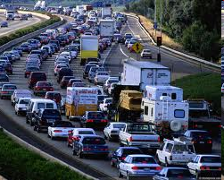
Queueing delay (revisited)
R: link bandwidth (bps)
L: packet length (bits)
a: average packet arrival rate
average queueing delay
traffic intensity
= La/R
La/R ~ 0: avg. queueing delay small
La/R -> 1: avg. queueing delay large
La/R > 1: more “work” arriving
than can be serviced, average delay infinite!
La/R ~ 0
La/R -> 1
Introduction
2-<number>

Slide 16
“Real” Internet delays and routes
what do “real” Internet delay & loss look like?
traceroute program: provides delay measurement from source to router along end-end Internet path towards destination. For all i:
  sends three packets that will reach router i on path towards destination
  router i will return packets to sender
  sender times interval between transmission and reply.
3 probes
3 probes
3 probes
Introduction
2-<number>

Slide 17
“Real” Internet delays, routes
traceroute: gaia.cs.umass.edu to www.eurecom.fr
3 delay measurements from
gaia.cs.umass.edu to cs-gw.cs.umass.edu
1 cs-gw (128.119.240.254) 1 ms 1 ms 2 ms
2 border2-rt-fa5-2-0.gw.umass.edu (128.119.3.145) 1 ms 1 ms 2 ms
3 cht-vbns.gw.umass.edu (128.119.3.130) 6 ms 5 ms 5 ms
4 jn2-at2-0-0-19.wor.vbns.net (204.147.132.129) 16 ms 11 ms 13 ms
5 jn2-so7-0-0-0.wae.vbns.net (204.147.136.136) 21 ms 18 ms 18 ms
6 abilene-vbns.abilene.ucaid.edu (198.32.11.9) 22 ms 18 ms 22 ms
7 nycm-wash.abilene.ucaid.edu (198.32.8.46) 22 ms 22 ms 22 ms
8 62.40.103.253 (62.40.103.253) 104 ms 109 ms 106 ms
9 de2-1.de1.de.geant.net (62.40.96.129) 109 ms 102 ms 104 ms
10 de.fr1.fr.geant.net (62.40.96.50) 113 ms 121 ms 114 ms
11 renater-gw.fr1.fr.geant.net (62.40.103.54) 112 ms 114 ms 112 ms
12 nio-n2.cssi.renater.fr (193.51.206.13) 111 ms 114 ms 116 ms
13 nice.cssi.renater.fr (195.220.98.102) 123 ms 125 ms 124 ms
14 r3t2-nice.cssi.renater.fr (195.220.98.110) 126 ms 126 ms 124 ms
15 eurecom-valbonne.r3t2.ft.net (193.48.50.54) 135 ms 128 ms 133 ms
16 194.214.211.25 (194.214.211.25) 126 ms 128 ms 126 ms
17 * * *
18 * * *
19 fantasia.eurecom.fr (193.55.113.142) 132 ms 128 ms 136 ms
trans-oceanic
link
* means no response (probe lost, router not replying)
Introduction
2-<number>

Slide 18
Packet loss
queue (aka buffer) preceding link in buffer has finite capacity
packet arriving to full queue dropped (aka lost)
lost packet may be retransmitted by previous node, by source end system, or not at all
buffer
(waiting area)
A
packet being transmitted
B
packet arriving to
full buffer is lost
Introduction
2-<number>

Slide 19
Throughput
throughput: rate (bits/time unit) at which bits transferred between sender/receiver
  instantaneous: rate at given point in time
  average: rate over longer period of time
server, with
file of F bits
to send to client
link capacity
R_{s} bits/sec
link capacity
R_{c} bits/sec
server sends bits
(fluid) into pipe
pipe that can carry
fluid at rate
R_{s} bits/sec)
pipe that can carry
fluid at rate
R_{c} bits/sec)
Introduction
2-<number>

Slide 20
Throughput (more)
R_{s} < R_{c} What is average end-end throughput?
R_{s} bits/sec
R_{c} bits/sec
R_{s} > R_{c} What is average end-end throughput?
R_{s} bits/sec
R_{c} bits/sec
bottleneck link
link on end-end path that constrains end-end throughput
Introduction
2-<number>

Slide 21
Throughput: Internet scenario
per-connection end-end throughput: min(R_{c},R_{s},R/10)
in practice: R_{c} or R_{s} is often bottleneck
R_{s}
R_{s}
R_{s}
R
R_{c}
R_{c}
R_{c}
10 connections (fairly) share backbone bottleneck link R bits/sec
Introduction
2-<number>

Slide 22
introduction: roadmap
  1.1 what is the Internet?
  1.2 network edge
    end systems, access networks, links
  1.3 network core
    packet switching, circuit switching, network structure
  1.5 Internet structure and ISPs
  1.6 delay, loss, throughput in networks
  1.7 protocol layers, service models
  1.8 networks under attack: security
  1.9 history
Introduction
2-<number>

Slide 23
More on Protocols
Protocols are the key to interoperability.
  Networks are very heterogenous:
  The hardware/software of communicating parties are often not built by the same vendor
  Yet they can communicate because they use the same protocol
Protocols exist at many levels.
  Application level protocols, e.g. access to mail, distribution of bboards, web access, ..
  Protocols at the hardware level allow two boxes to communicate over a link, e.g. the Ethernet protocol
Computer: x86 Ethernet: 3com Routers: cisco, etc. App: Email | Hardware Hardware/link Network Application

Slide 24
Implementing Protocol
Requirements for packets:
  Packet size limit?
  Header information: Addresses, etc.
  From where/who, to where ? Naming and address
    POST, Telephone
Almost in all lectures
Q: The relationship between Data link layer name and IP name?

Slide 25
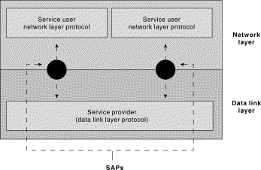
Interfaces
Each protocol offers an interface to its users, and expects one from the layers on which it builds
  Syntax and semantics strike again
    Data formats
    Interface characteristics, e.g. IP service model
Protocols build upon each other
  Add value
    E.g., a reliable protocol running on top of IP
  Reuse
    E.g., OS provides TCP, so apps don’t have to rewrite

Slide 26
Too Many Network Components
Application
Application
Router Software
(many protocols)
Operating System
Operating System
Links
Computer
Network Interface
Protocol Software
Router Hardware
Computer
Bridge HW/SW

Slide 27
Too many components 2
Links: copper, fiber, air
Running ethernet, token ring, SONET, FDDI
Routers speaking BGP, OSPF, RIP, …
Hosts running FreeBSD, Linux, Windows, MacOS, …
People using Mozilla, Explorer, Opera, …
and it changes all the time
Protocols hide this stuff with simple abstractions.

Slide 28
Example: no abstraction
Web
FTP
Telnet
Voice
Video
Tw. Pair
Coax
Optical
Wireless

Slide 29
Three layers model :
Hardware abstraction
Web
FTP
Telnet
Voice
Intermediate Layer
Tw. Pair
Coax
Optical
Wireless
Introduction
2-<number>

Slide 30
Protocol and
Service Levels
How to do abstractions?
End-to-end abstraction
Application
End-to-end
Core
Network
Communication
functions

Slide 31
Looking at protocols
Hop by hop / link protocols (communication related)
  Ethernet
End-to-end protocols (app related)
  TCP, apps, etc.
Management / “control plane” protocols
  Routing, etc.
    Can be either link or e2e themselves
    Definition somewhat vague.
Standards
  File/Packet formats, etc.
      E.g., JPEG, MPEG, MP3, …
Different way to abstraction

Slide 32
A Layered Network Model
The Open Systems Interconnection (OSI) Model.
7
Application
Application
6
Presentation
Presentation
5
Session
Session
4
Transport
Transport
3
Network
Network
Network
2
Data link
Data link
Data link
1
Physical
Physical
Physical

Slide 33
OSI Motivation
Standard way of breaking up a system in a set of components, but the components are organized as a set of layers.
  Only horizontal and vertical communication
  Components/layers can be implemented and modified in isolation
Each layer offers a service to the higher layer, using the services of the lower layer.
“Peer” layers on different systems communicate via a protocol.
  higher level protocols (e.g. TCP/IP, Appletalk) can run on multiple lower layers
  multiple higher level protocols can share a single physical network
“It’s only a model!” - TCP/IP has been crazy successful, and it’s not based on a rigid OSI model. But the OSI model has been very successful at shaping thought.

Slide 34
OSI Functions
(1) Physical: transmission of a bit stream.
(2) Data link: flow control, framing, error detection.
(3) Network: switching and routing.
(4) Transport: reliable end to end delivery.
(5) Session: managing logical connections.
(6) Presentation: data transformations.
(7) Application: specific uses, e.g. mail, file transfer, telnet, network management.
Multiplexing takes place in multiple layers

Slide 35
Example: Sending a Web Page
Http hdr
Web page
Application
Presentation
. . .
Session
Transport
Network
TCP
header
Application
payload
Data link
Physical

Slide 36
A TCP / IP / 802.3 Packet
Application
Ethernet preamble
Presentation
MAC header
Session
LLC / SNAP header
Transport
IP header
Network
TCP header
Data link
Physical
Data

Slide 37
Multiplexing and Demultiplexing
There may be multiple implementations of each layer.
  How does the receiver know what version of a layer to use?
Each header includes a demultiplexing field that is used to identify the next layer.
  Filled in by the sender
  Used by the receiver
Multiplexing ooccurs at multiple layers. E.g., IP, TCP, …
TCP
TCP
IP
IP
V/HL
TOS
Length
ID
Flags/Offset
TTL
Prot.
H. Checksum
Source IP address
Destination IP address
Options..

Slide 38
Different Sources of
Components
Application: web server/browser, mail, distributed game,..
Presentation/session.
  Often part of application
  Sometimes a library
Transport/network.
  Typically part of the operating system
Datalink.
  Often written by vendor of the network interface hardware
Physical.
  Hardware: card and link
Application
Presentation
Session
Transport
Network
Data link
Physical

Slide 39
Why layering?
dealing with complex systems:
explicit structure allows identification, relationship of complex system’s pieces
  layered reference model for discussion
modularization eases maintenance, updating of system
  change of implementation of layer’s service transparent to rest of system
  e.g., change in gate procedure doesn’t affect rest of system
layering considered harmful?
Introduction
2-<number>

Slide 40
Limitations of the Layered Model
Some layers are not always cleanly separated.
  Inter-layer dependencies in implementations for performance reasons
  Some dependencies in the standards (header checksums)
Higher layers not always well defined.
  Session, presentation, application layers
Lower layers have “sublayers”.
  Usually very well defined (e.g., SONET protocol)
Interfaces are not really standardized.
  It would be hard to mix and match layers from independent implementations, e.g., windows network apps on unix (w/out compatability library)
  Many cross-layer assumptions, e.g. buffer management

Slide 41
The TCP/IP Model
Application
Application
(plus
libraries)
Presentation
Session
TCP/UDP
IP/ICMP
Transport
Network
Data link
Data link
Physical
Physical

Slide 42
Local Area Network Protocols
IEEE 802 standards “refine” the OSI data link layer.
Application
Presentation
Upper
Layer
Protocols
Session
Transport
link service
access points
Network
LLC
Data link
MAC
Physical
Physical

Slide 43
Internetworking Options
7
7
7
7
6
6
6
6
5
5
5
5
4
4
4
4
3
3
3
data link
3
2
physical
2
2
2
2
1
1
1
1
1
1
1
repeater
bridge
(e.g. 802 MAC)
7
7
7
7
6
6
6
6
5
5
5
. . .
5
4
network
4
4
4
3
3
3
3
3
3
3
2
2
2
2
2
2
2
2
1
1
1
1
1
1
1
1
router
gateway

Slide 44
Encapsulation
source
message
M
application
transport
network
link
physical
segment
H_{t}
M
H_{t}
datagram
H_{n}
H_{n}
H_{t}
M
frame
H_{l}
H_{n}
H_{t}
M
link
physical
switch
destination
H_{n}
H_{t}
M
network
link
physical
M
application
transport
network
link
physical
H_{l}
H_{n}
H_{t}
M
H_{n}
H_{t}
M
H_{t}
M
H_{n}
H_{t}
M
H_{l}
H_{n}
H_{t}
M
router
Introduction
2-<number>

Slide 45
The Internet Protocol Suite
application
transport
network
link
physical
Applications
Presentation
Session
UDP
TCP
Waist
Data Link
Physical
The waist facilitates Interoperability.
The Hourglass Model

Slide 46
Organization of air travel
ticket (purchase)
baggage (check)
gates (load)
runway takeoff
airplane routing
ticket (complain)
baggage (claim)
gates (unload)
runway landing
airplane routing
airplane routing
a series of steps
Introduction
2-<number>

Slide 47

Layering of airline functionality
ticket (purchase)
baggage (check)
gates (load)
runway (takeoff)
airplane routing
ticket (complain)
baggage (claim
gates (unload)
runway (land)
airplane routing
ticket
baggage
gate
takeoff/landing
airplane routing
airplane routing
airplane routing
departure
airport
intermediate air-traffic
control centers
arrival
airport
layers: each layer implements a service
  via its own internal-layer actions
  relying on services provided by layer below
Introduction
2-<number>

Slide 48
Internet protocol stack
application: supporting network applications
  FTP, SMTP, HTTP
transport: process-process data transfer
  TCP, UDP
network: routing of datagrams from source to destination
  IP, routing protocols
link: data transfer between neighboring network elements
  Ethernet, 802.111 (WiFi), PPP
physical: bits “on the wire”
application
transport
network
link
physical
Introduction
2-<number>

Slide 49
ISO/OSI reference model
presentation: allow applications to interpret meaning of data, e.g., encryption, compression, machine-specific conventions
session: synchronization, checkpointing, recovery of data exchange
Internet stack “missing” these layers!
  these services, if needed, must be implemented in application
  needed?
application
presentation
session
transport
network
link
physical
Introduction
2-<number>

Slide 50
introduction: roadmap
  1.6 delay, loss, throughput in networks
  1.7 protocol layers, service models
  1.8 networks under attack: security
  1.9 history
Introduction
2-<number>

Slide 51
Network security
field of network security:
  how bad guys can attack computer networks
  how we can defend networks against attacks
  how to design architectures that are immune to attacks
Internet not originally designed with (much) security in mind
  original vision: “a group of mutually trusting users attached to a transparent network” ☺
  Internet protocol designers playing “catch-up”
  security considerations in all layers!
Introduction
2-<number>

Slide 52
Bad guys: put malware into hosts via Internet
malware can get in host from:
  trojan horse: hidden in otherwise useful software
  virus: self-replicating infection by receiving/executing object (e.g., e-mail attachment)
  worm: self-replicating infection by passively receiving object that gets itself executed
spyware malware can record keystrokes, web sites visited, upload info to collection site
infected host can be enrolled in botnet, used for spam. DDoS attacks
Introduction
2-<number>

Slide 53

Bad guys: attack server, network infrastructure
Denial of Service (DoS): attackers make resources (server, bandwidth) unavailable to legitimate traffic by overwhelming resource with bogus traffic
1. select target
2. break into hosts around the network (see botnet)
3. send packets to target from compromised hosts
target
Introduction
2-<number>

Slide 54
Bad guys can sniff packets
packet “sniffing”:
  broadcast media (shared ethernet, wireless)
  promiscuous network interface reads/records all packets (e.g., including passwords!) passing by
A
C
src:B dest:A payload
B
  wireshark software is a (free) packet-sniffer
Introduction
2-<number>

Slide 55
Bad guys can use fake addresses
IP spoofing: send packet with false source address
A
C
src:B dest:A payload
B
Combining with Dos attack;
Can design a new type Dos attack: Reflection DDos
Introduction
2-<number>

Slide 56

Bad guys can record, playback
record-and-playback: sniff sensitive info (e.g., password), and use later
  password holder is that user from system point of view
C
A
src:B dest:A user: B; password: foo
B
Introduction
2-<number>

Slide 57
introduction: roadmap
  1.1 what is the Internet?
  1.3 network core
    packet switching, circuit switching, network structure
  1.6 delay, loss, throughput in networks
  1.7 protocol layers, service models
  1.8 networks under attack: security
  1.9 history
Introduction
2-<number>

Slide 58
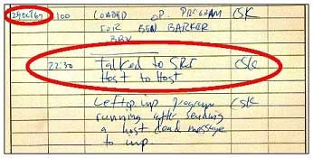
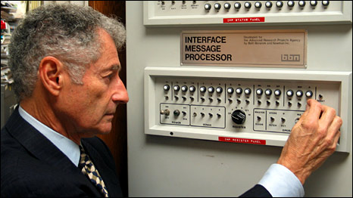
Internet history
1962-1972: Early packet-switching principles
1961: Kleinrock - queueing theory shows effectiveness of packet-switching
1964: Baran - packet-switching in military nets
1967: ARPAnet conceived by Advanced Research Projects Agency
1969: first ARPAnet node operational
  First link: UCLA-SRI
Introduction
2-<number>

Slide 59

Internet history
1962-1972: Early packet-switching principles
1969: first ARPAnet node operational
  Dec 5, 4 nodes
1972:
  ARPAnet public demo
  NCP (Network Control Protocol) first host-host protocol
  first e-mail program
  ARPAnet has 15 nodes
Introduction
2-<number>

Slide 60
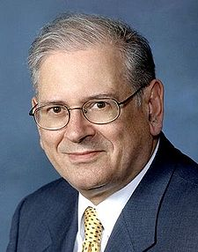
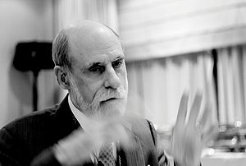
Internet history
1972-1980: Internetworking, new and proprietary nets
1970: ALOHAnet satellite network in Hawaii
1974: Cerf and Kahn - architecture for interconnecting networks
Cerf and Kahn’s internetworking principles:
  minimalism, autonomy - no internal changes required to interconnect networks
  best effort service model
  stateless routers
  decentralized control
define today’s Internet architecture
Introduction
2-<number>

Slide 61


Internet history
1972-1980: Internetworking, new and proprietary nets
1976: Ethernet at Xerox PARC
late70’s: proprietary architectures: DECnet, SNA, XNA
late 70’s: switching fixed length packets (ATM precursor)
1979: ARPAnet has 200 nodes
1983: deployment of TCP/IP
Bill Joy: TCP/IP in BSD UNIX

Slide 62

Internet history
1980-1990: new protocols, a proliferation of networks
1982: smtp e-mail protocol defined
1983: DNS defined for name-to-IP-address translation
1985: ftp protocol defined
1983 !
Jan 1, TCP/IP deployment
new national network backbones: Csnet, BITnet, NSFnet, Minitel
1988:
-TCP congestion control
-First network worms
-100,000 hosts connected to confederation of networks
Robert Tappan Morris
Introduction
2-<number>

Slide 63
Internet history
1990, 2000’s: commercialization, the Web, new apps
early 1990’s: ARPAnet decommissioned
1991: NSF lifts restrictions on commercial use of NSFnet (decommissioned, 1995)
early 1990s: Web
  hypertext [Bush 1945, Nelson 1960’s]
  HTML, HTTP: Berners-Lee
  1994: Mosaic, later Netscape
  late 1990’s: commercialization of the Web
late 1990’s – 2000’s:
more killer apps: instant messaging, P2P file sharing
network security to forefront
est. 50 million host, 100 million+ users
backbone links running at Gbps
Introduction
2-<number>

Slide 64
Internet history
2010~:
>750 million hosts
voice, video over IP
P2P applications: BitTorrent (file sharing) Skype (VoIP), PPLive (video)
more applications: facebook, YouTube, gaming, Twitter
wireless, mobility
Introduction
2-<number>

Slide 65
Introduction: summary
covered a “ton” of material!
Internet overview
what’s a protocol?
network edge, core, access network
  packet-switching versus circuit-switching
  Internet structure
performance: loss, delay, throughput
layering, service models
security
history
you now have:
context, overview, “feel” of networking
more depth, detail to follow!
Introduction
2-<number>

